Slide 1
Practicing Project phase - 1
Friend Recommendation Algorithm
G. Aswin : 1RN19CS048
Abhijna Shetty :1RN19CS002
Github Link to the Project

Slide 2
Introduction- relevance of the topic
Every social media/social networking platform uses an internal graph to store the data of their users.
Users are represented by nodes and edges between them signifies a connection.
Facebook uses an undirected graph – both users are always friends with each other, whereas twitter and Instagram uses a di-graph as in – a user can follow someone without the other person following back.

Slide 3
Introduction- continued
Recommendation algorithms are extremely important because companies try to recommend what we as users are most likely to click/watch.
Lots of data is used to try to predict what exactly needs to be presented to us next.
In this project we have tried to simulate a small part of it by creating and managing a graph of users and an algorithm to recommend future connections to users.

Slide 4
problem statement
To simulate a social networking platform by using graph concepts for storing users and apply simple graph algorithms for friend recommendation.

Slide 5
Technological Requirements
Software Requirement-
TOOLS USED:
VS Code and Online GDB for editing
GCC 11 and Online GDB for compile and run.
Github for version control.
IT IS OS INDEPENDENT

Slide 6
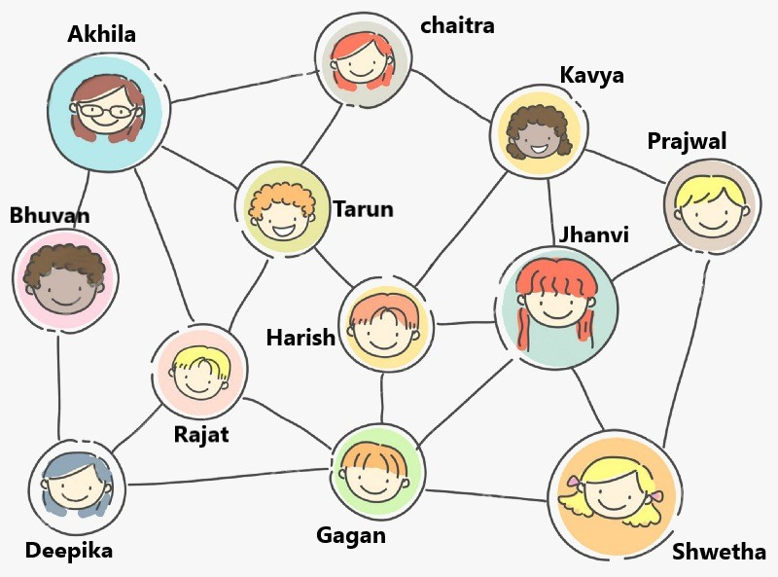
Demo Graph
Dancing
Singing
Bookreading
Singing
Bookreading
Dancing
Bookreading
Singing
Singing
Bookreading
Dancing
Singing

Slide 7
Structure of each person node
struct people
{
int id;
char name[100];
char gender;
int age;
char city[100];
char hobby[25];
int friends;
};
typedef struct people *user;
This is the structure definition of the node. It stores all the concerned details of a person.

Slide 8
Graph implementation
struct people database[100];
int adjacency_matrix[100][100] = {0};
int active_accounts = 0;
Database is an array of person structure. It contains all the actual data.
Adjacency_matrix is a 100*100 integer matrix which holds the edge data of the graph.
Active_accounts is a counter of total number of accounts till now.

Slide 9
Thank you
Queries ??

